Slide 1
Pipelines
Justin Hooker
Sy Ahmed

Slide 2
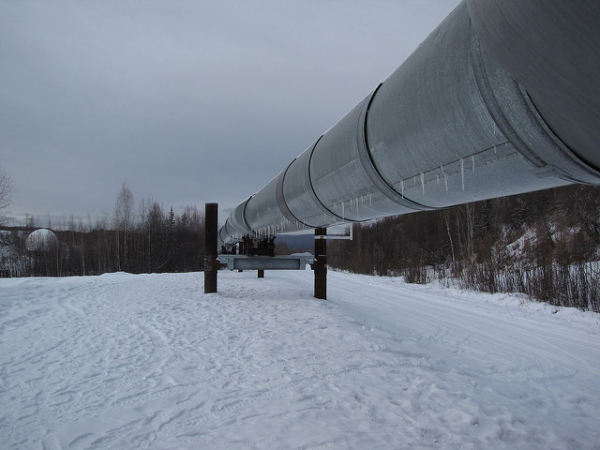
Machine Learning Pipelines
There are standard workflows in a machine learning project that can be automated
Utility that allows a linear sequence of data transformations to chained together
Great way to organize models
Notes:
Scikit learn provides the pipeline utility that allows us to chain a linear sequence of data transformations
Transformations are seen as a data in data out black box
Transformation objects contain a fit and transform method

Slide 3
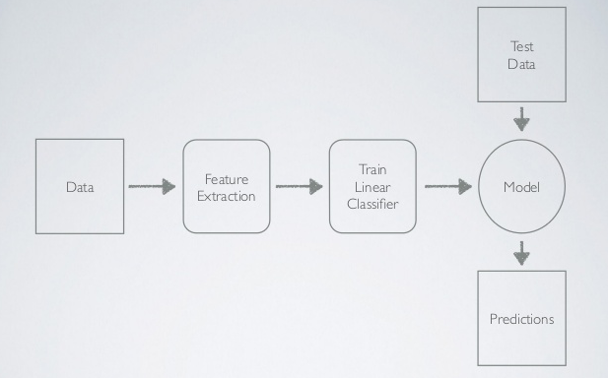
Notes:
Standard machine learning pipeline

Slide 4
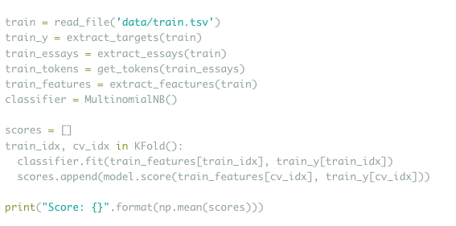
Implementing Multinomial NB on text data

Slide 5
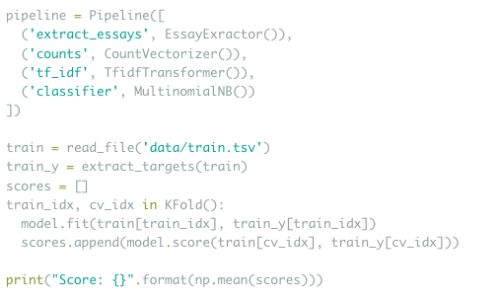
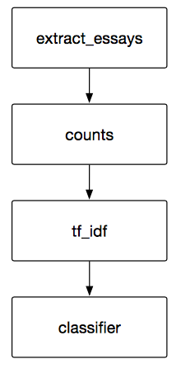
Implementing Multinomial NB on text data with scikit-learn Pipeline
Notes:
Using a Pipeline simplifies this process. Instead of manually running through each of these steps, and then tediously repeating them on the test set, you get a nice, declarative interface where it’s easy to see the entire model.

Slide 6
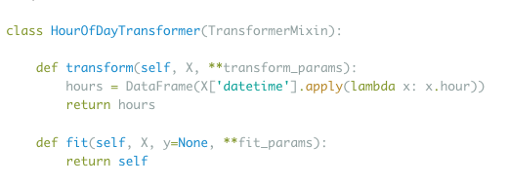
Custom transformers
Transformer - data in data out black box
Stateless Transformer
Notes:
A transformer is thought of as a data in data out black box
Custom transformer - a transformer object is an object that responds to fit, transform, and fit-transform. The easiest way to do this is by inheriting Transformermixin.
Stateless transformer - transformer that does not need to be fitted

Slide 7
Data Leakage
Leaking knowledge of of the whole dataset to the algorithm
Pipelines help you prevent data leakage in your test harness by ensuring that data preparation like standardization is constrained to each fold of your cross validation procedure.

Slide 8
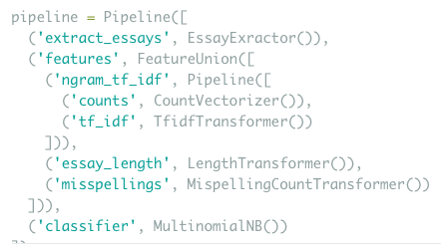
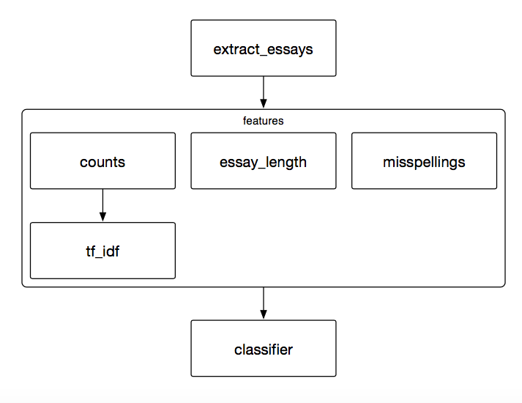
Feature Unions
Notes:
Feature unions are used to extract more features within a pipeline

Slide 9
Final Thoughts
The last step of a pipeline is assumed to be the final estimator, so predict method is called instead of transform. For this reason any post processing is done outside of the pipeline.
Pipelines do not support fit_partial API, so out-of-core training is not possible.
2 Important use cases:
Data preparation and modeling
Feature extraction and feature union
Adapting, improving models and hyperparameter gridsearch
Notes:
While the initial investment is higher, designing my projects this way ensures that I can continue to adapt and improve my model while keeping all the steps straight. It really starts to pay off when you get into hyperparameter tuning.

Slide 10
Demo

Slide 11
Resources
http://zacstewart.com/2014/08/05/pipelines-of-featureunions-of-pipelines.html
https://machinelearningmastery.com/automate-machine-learning-workflows-pipelines-python-scikit-learn/

